Slide 1

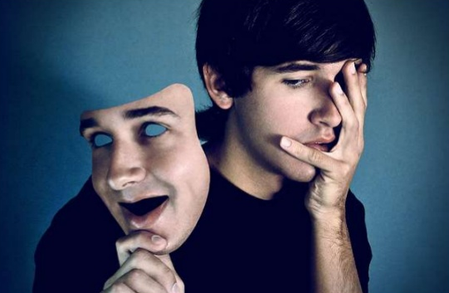
THE HUMAN PERSONALITY
TOPIC BY
Dr. Priyanka Somasundaram

Slide 2
INTRODUCTION
Defined as:
The way we think, feel, perceive, and react to the external world
“SWABHAAVA” – covers all aspects of personality & essential quality.
Action governed by Swabhaava – the essential law of one’s own nature.
Its core the pure quality of the spirit in its inherent power of consciousness will and in its characteristic force of action

Slide 3
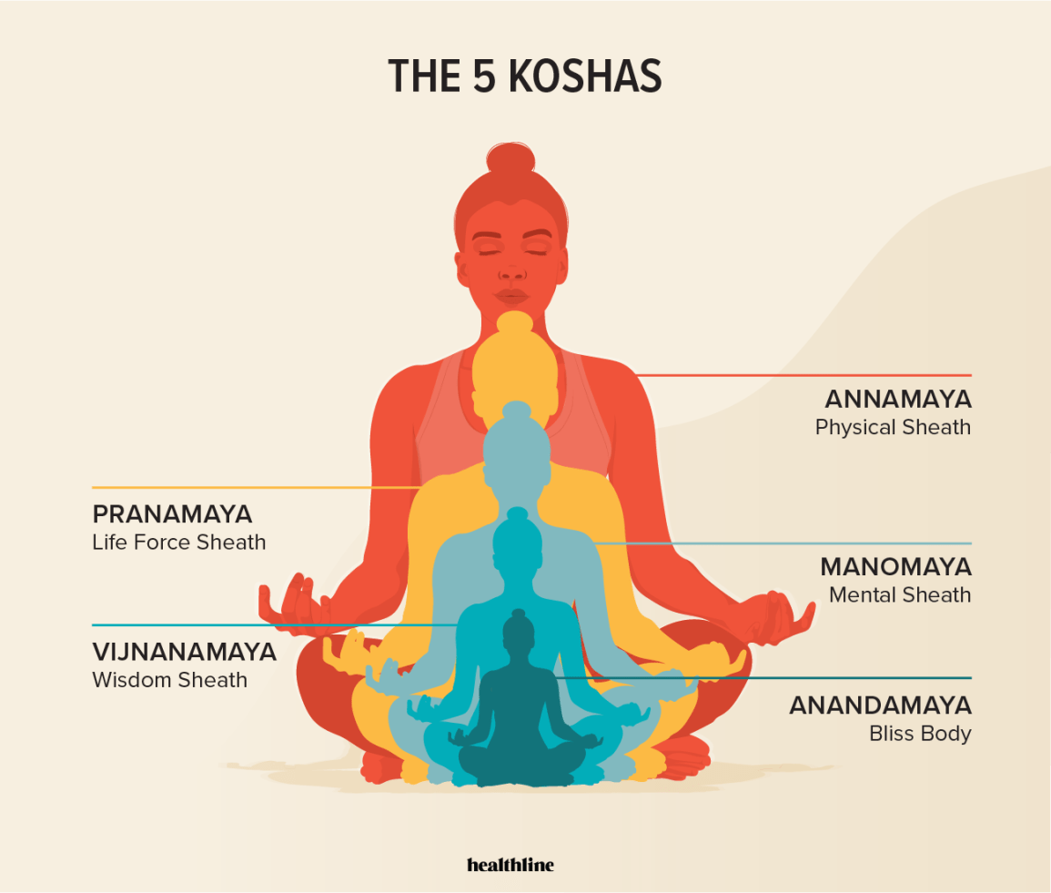
PANCHAKOSHA
THE HUMAN PERSONALITY

Slide 4
INTRODUCTION
Pancha – 5
Kosha – Sheath or covering or layer
Its mentioned in Taitriya Upanisheds ‘Its vedantic psycho-philosophical view of human personality.

Slide 5
ANNAMAYA KOSHA:
Organic state of the body
Food sheath & nourished by Food
Performs activity like eating, drinking, walking etc..

Slide 6
PRANAMAYA KOSHA:
The state of energy body & vitality
Vital air sheath
Nourished by Prana & bioenergy

Slide 7
MANOMAYA KOSHA:
PSYCHIC STATE
Mental Sheath
Its deals with feeling, thoughts
Nourished by Education

Slide 8
VIJNANAMAYA KOSHA:
The state of intellectual body, spiritual discrimination & wisdom
Intellectual Sheath
Nourished by Ego

Slide 9
ANANDAMAYA KOSHA
Nourished by emotions
Bliss sheath

Slide 10
BODY – MIND COMPLEX

Slide 11
Three Bodies
Human bodies has 3 different bodies where this 5 kosha reside
Gross body – Stula sarira [Annamaya Kosha]
Contains five elements
Subtle body – sushmana sarira / astral body/ Linga sarira [Pranamaya Kosha, Manomaya Kosha]
emotions, images, dreams, etc., as well as the energy structure: chakras, nadis, adharas;
Causal body – karana sarira [Vijnanamaya ] [map template which is the solo cause for the gross & subtle bodies]
contains person`s karma, information about one’s reincarnations.

Slide 12
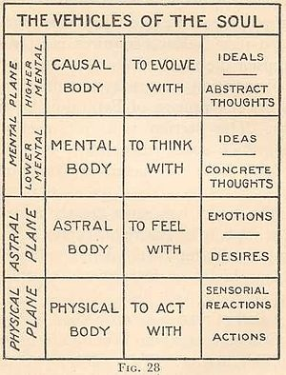

Slide 13
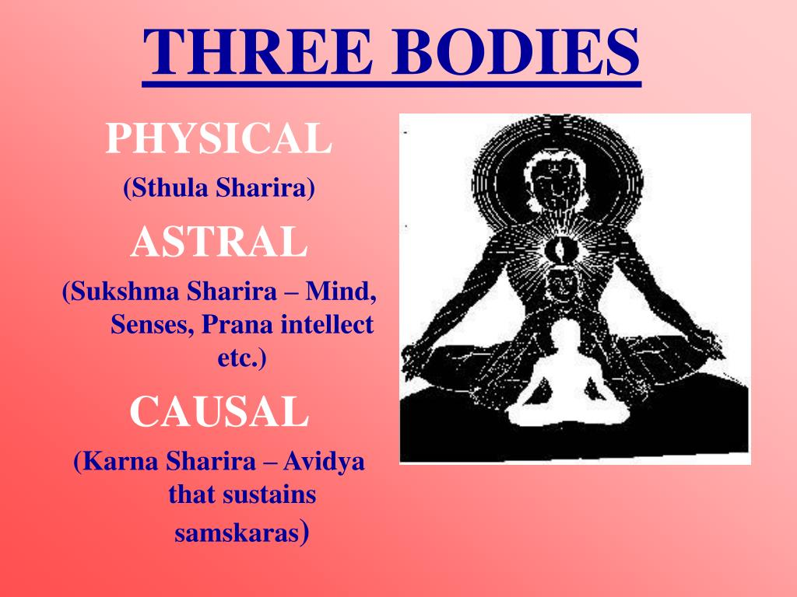

Slide 14
TRIGUNAS:

Slide 15
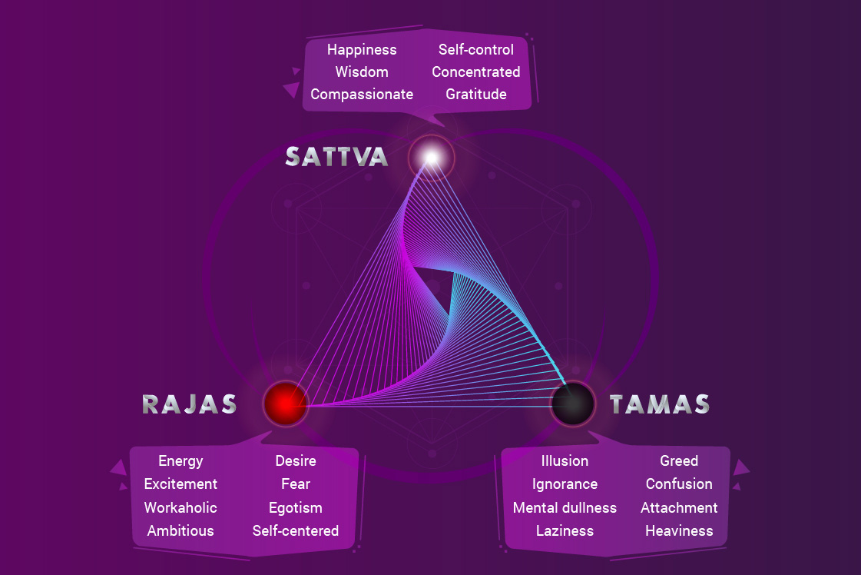

Slide 16
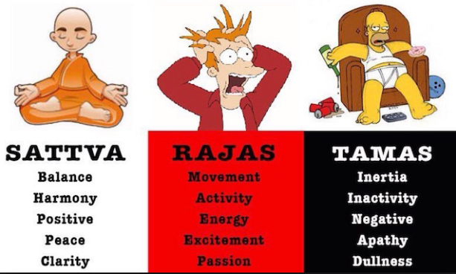

Slide 17
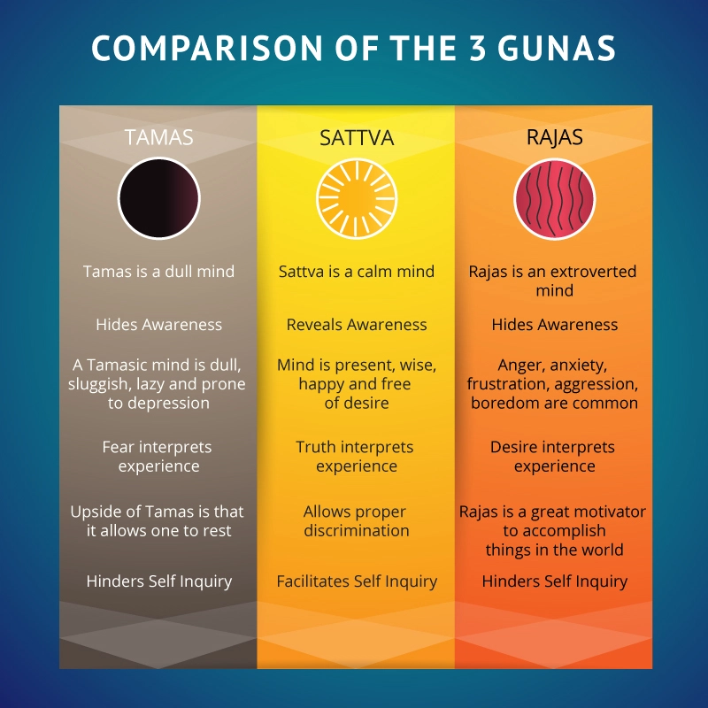

Slide 18
B – M – I CHART

Slide 19
B M I CHART
B --- P ---- O
M --- F --- E
I --- T --- T

Slide 20
Organs of action
Organs of action | Functions
Legs | Movement
Hands | Working
Tongue | Speech
Reproductive organ | Progeny
Excretory organ | Elimination

Slide 21
Organs of Perception
Functions | Organs of perception
Visual | Eyes
Hearing | Ears
Smelling | Nose
Taste Buds & Speech | Tongue
Perceive touch | Skin

Slide 22
D/B/W MANAS & BHUDDHI
MANAS - continuous flow of thought
Sleep state & wake state
Sleep state – no flow of thought because we are in unconscious state
Very fluctuating & Indecisive

Slide 23
D/B/W MANAS & BHUDDHI
Bhuddhi – Intellectual
Think & decide
Decisiveness & stedyness

Slide 24
VASANAS:
Every little thing we do in this world leaves its impressions on our Sub conscious mind ------ VASANAS
All this action propel us into certain action
We al ready born Blue print
Cause – effect relation [which comes 1st ?, no conclusion]

Slide 25

Ink plot test:

Slide 26


